Slide 1

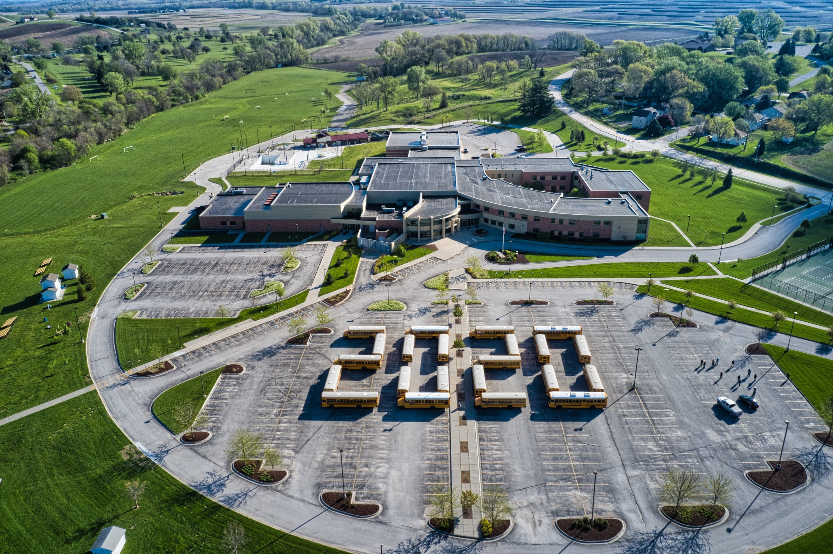
Glenwood Girls
Track and Field
2020
Go Take It

Slide 2

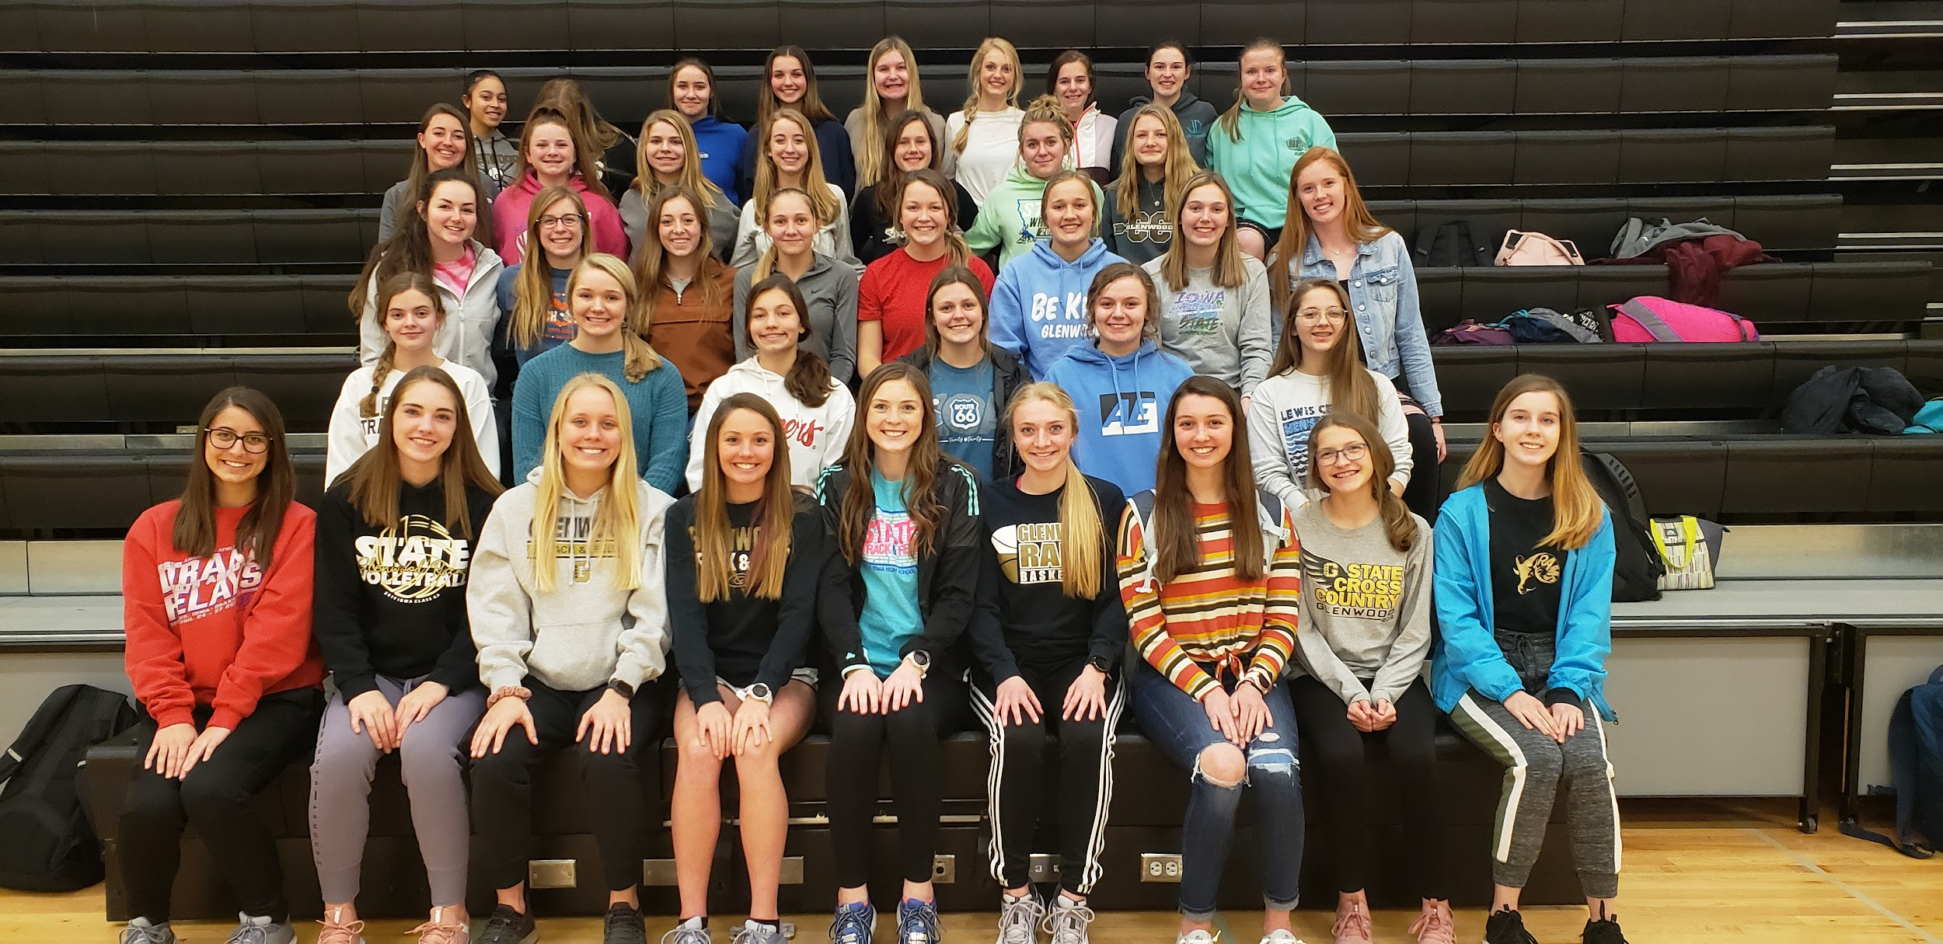

Glenwood Rams:
2020 Track Champions
Champions of Character
Champions of Team Culture
Champions of Overcoming Adversity
“Any [wo]man can win when things go [her] way; it’s the [wo]man who overcomes adversity that is the true champion.”
-Jack Ewing

Slide 3

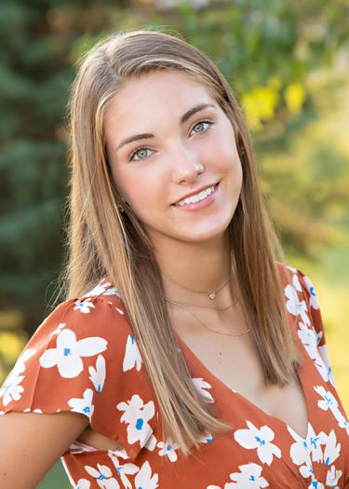

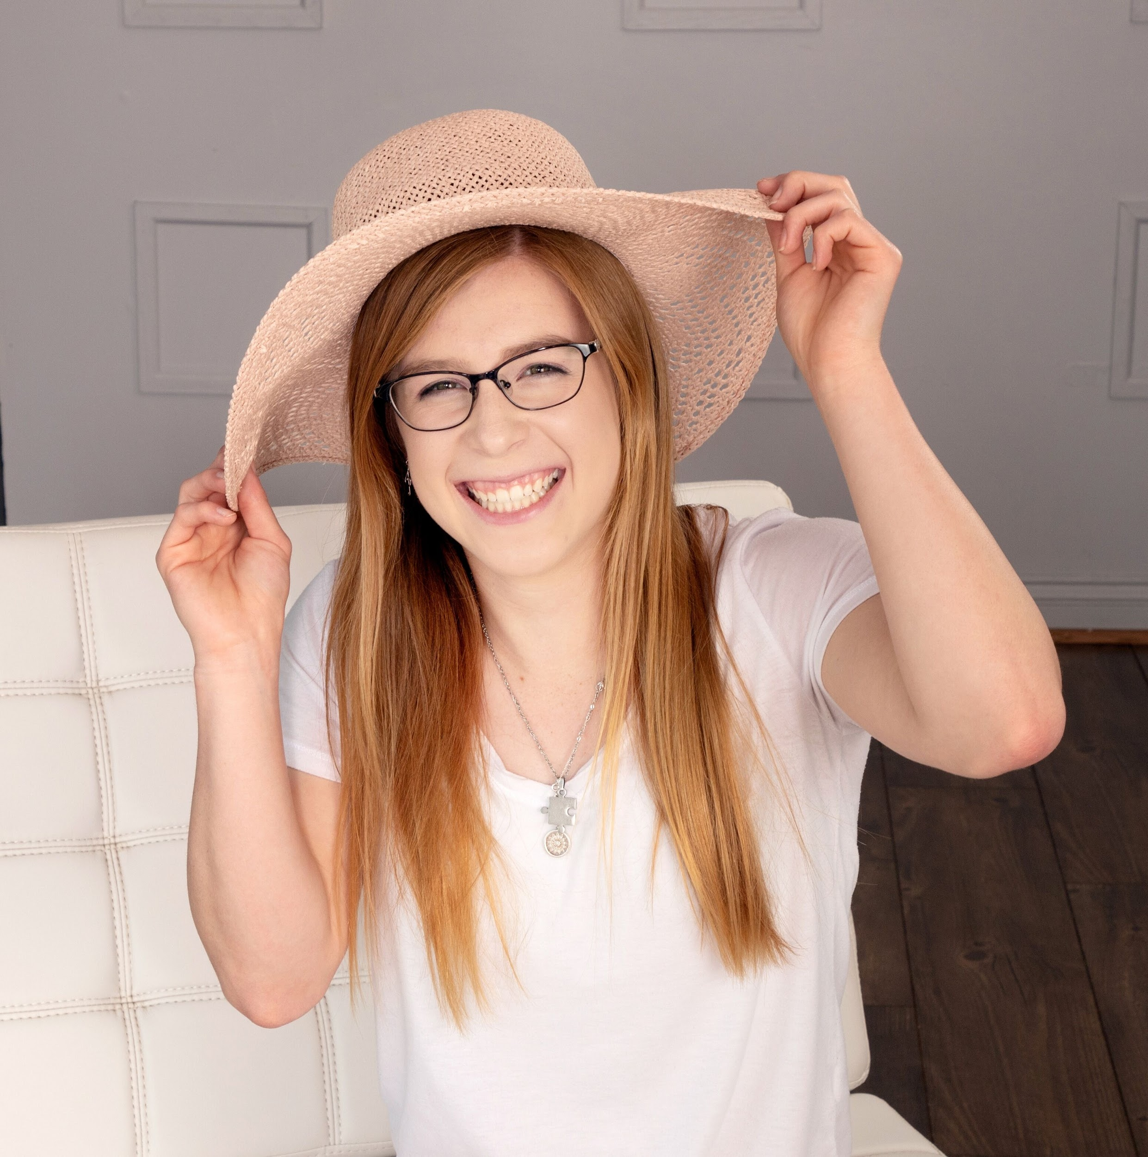
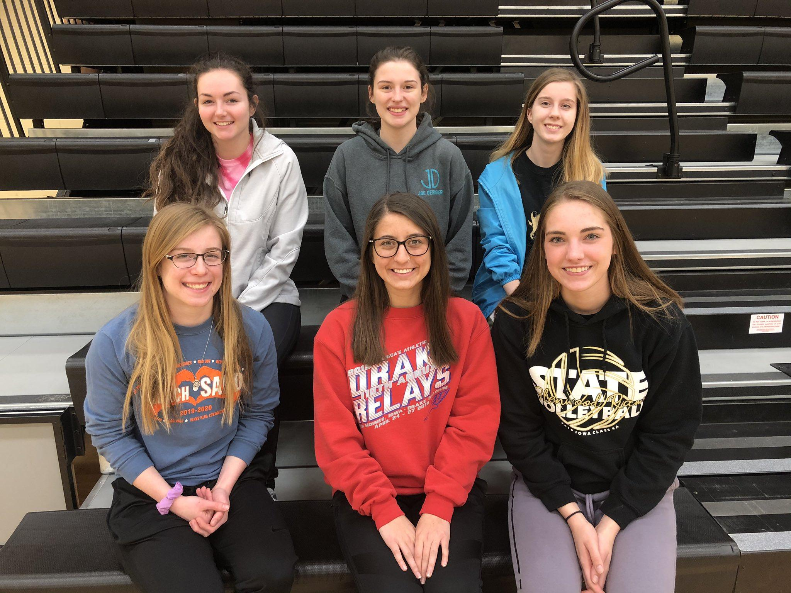
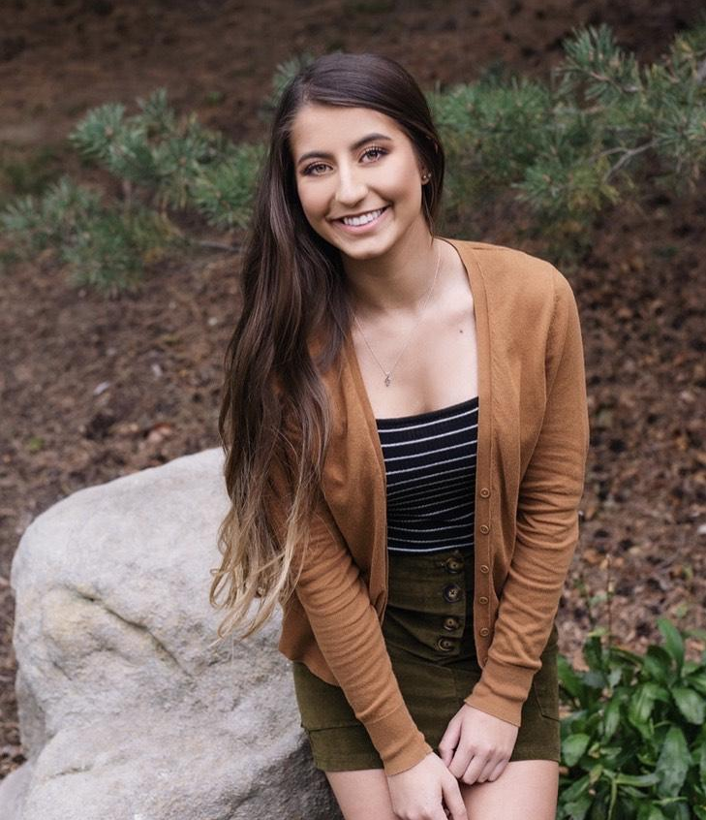
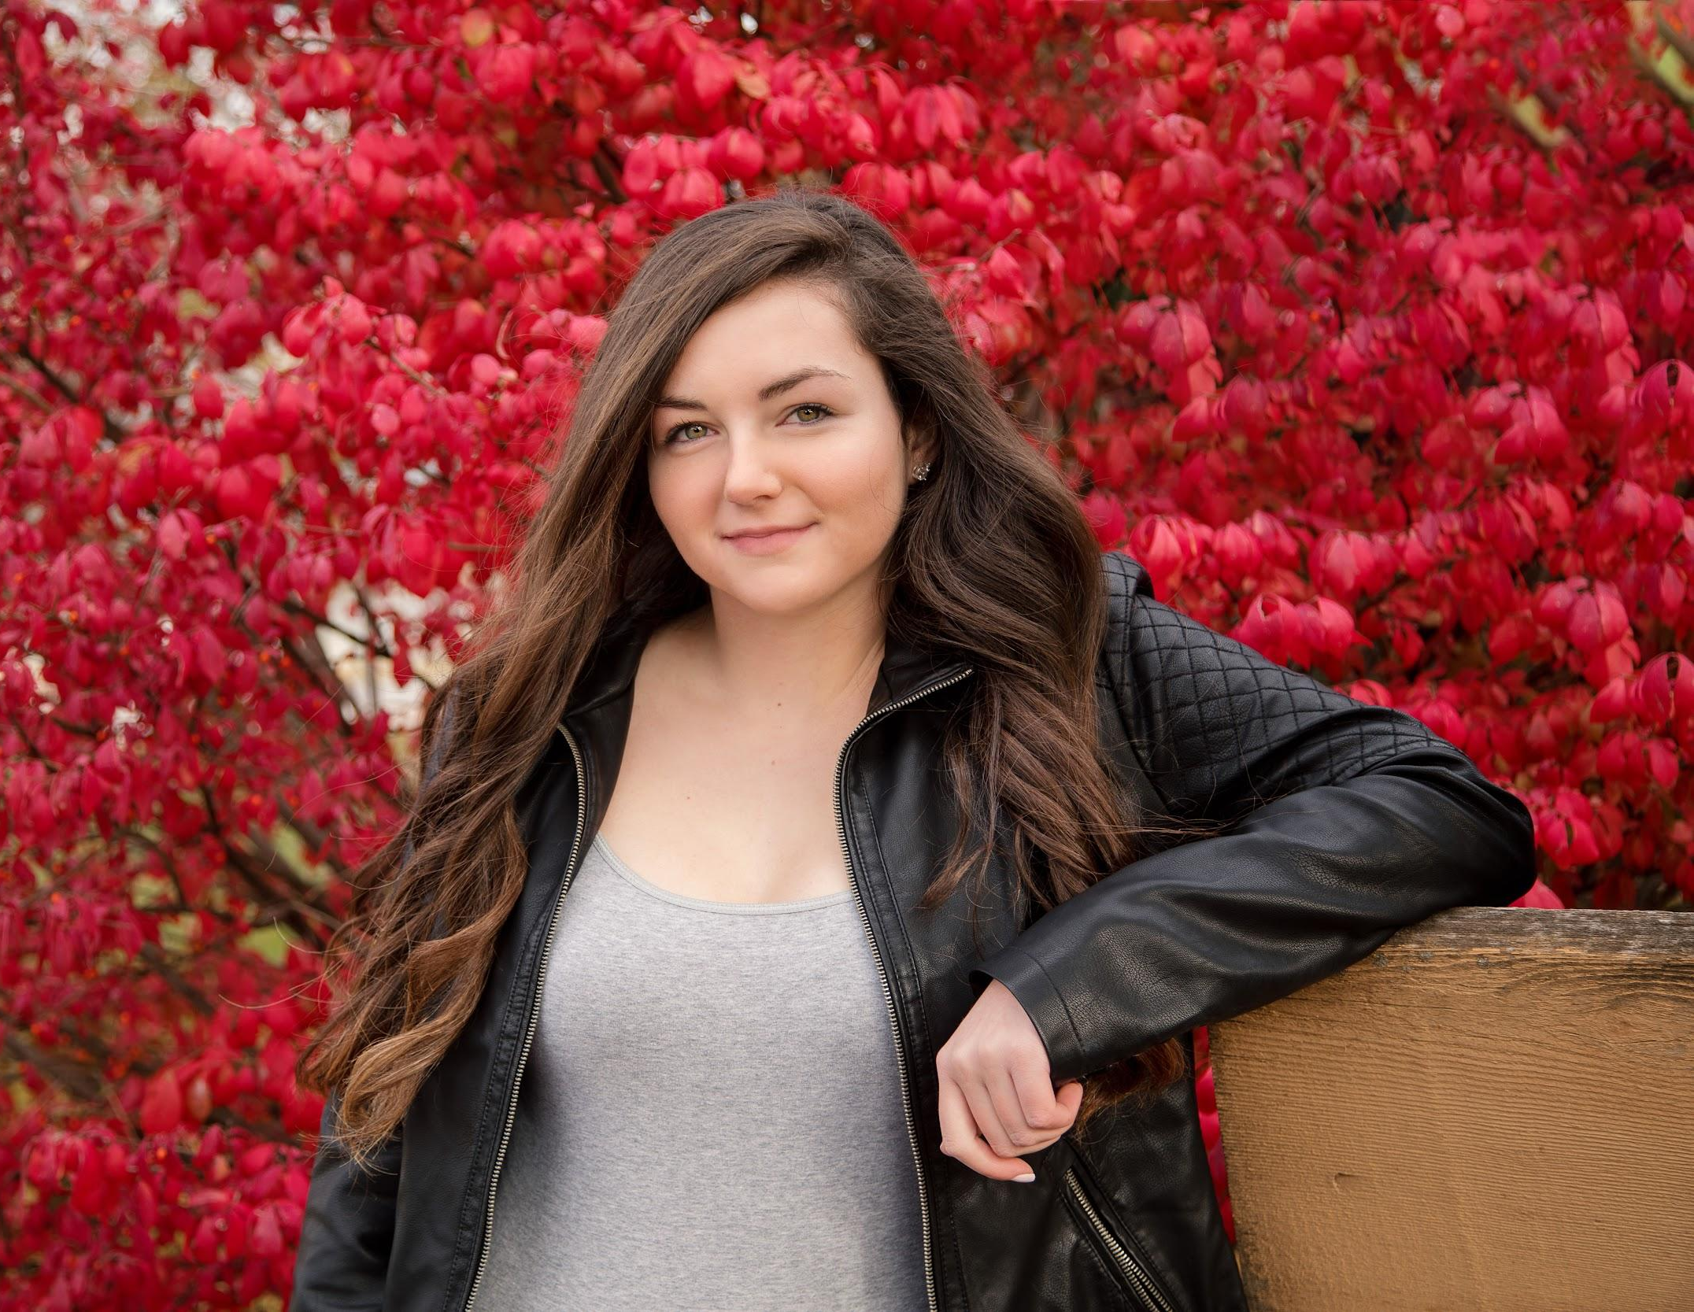
Congratulations Seniors 2020
“Every adversity, every failure, every heartache carries with it the seed of an equal or greater benefit.”
-Napoleon Hill
Congratulations, Seniors! May the seeds you planted bloom as you continue on your journey.

Slide 4
George Peterson Outstanding Track Athlete Award
The George Peterson Outstanding Track Athlete Award winner is chosen by the head coach, assistant coaches, athletic director, and high school principal based on athlete performance, attitude, contribution, and citizenship. This honor is not necessarily awarded to a senior, but any member of the track team exemplifying these qualities.
Year Winner
1969-1970 Linda Rowe
1970-1971 Linda Rowe
1971-1972 Pat Hodgson
1972-1973 Pat Hodgson
1973-1974 Pat Hodgson
1974-1975 Laurie Maiers
1975-1976 Julie Mingo
1976-1977 Julie Mingo
1977-1978 Lori Karr
1978-1979 Michelle Rohberg
1979-1980 Nancy Williams
1980-1981 Kim Smith
1981-1982 Jeani Rupe
1982-1983 Kim Smith
1983-1984 Kim Smith
1984-1985 Brenda Konfrst
1985-1986 Brenda Konfrst
1986-1987 Becky Osterholm
1987-1988 Tammy Meyers
1988-1989 Jenny O'Grady
1989-1990 Suzanne Jankiewicz
1990-1991 Suzanne Jankiewicz
1991-1992 Chrissy Wray
1992-1993 Chrissy Wray
1993-1994 Chrissy Wray
1994-1995 Stephanie Schoening,
Kelly Fair & Desi Melgoza
1995-1996 Jamie Reinert
1996-1997 Rachael Schoening
1997-1998 Kristi Zillmer
1998-1999 Rachael Schoening
1999-2000 Sarah Nord
2000-2001 Sarah Nord & Lynette Woodrow
2001-2002 Lynette Woodrow & Kristina Ludwig
2002-2003 Katie Wilson & Sarah Jens
2003-2004 Katie Wilson
2004-2005 Jenny Dashner
2005-2006 Anna Young
2006-2007 Paige Hays, Rachel Stanley &
Alisa Winquist
2007-2008 Sophie Ringsdorf
2008-2009 Sophie Ringsdorf, Jenna
Turcotte & Katie Staiert
2009-2010 Shaniece Nott & Katie Larsen
2010-2011 Lexi Fisher
2011-2012 Lexi FIsher
2012-2013 Reiny Ostrander
2013-2014 Jacy Embray & Miranda Ruth
2014-2015 Jacy Embray
2015-2016 Linnaea Konfrst & Molly Dean
2016-2017 Jillian Finnegan & Devon
Bomer
2017-2018 Bailey Ostrander
2018- 2019 Bailey Ostrander & Janette
Schraft

Slide 5
Program Records
Event Name Time Year
Shot Put Brenda Konfrst 45' 1 1986
Discus Brenda Konfrst 142' 10 1986
Long Jump Linda Rowe 16' 11 ½ 1970
High Jump Claire Bristow 5' 5 2006
100 Meters Laurie Maiers 12.3 1975
200 Meters Pat Hidgson 26.2 1974
400 Meters Janette Shraft 57.64 2019
800 Meters Janette Shraft 2:11.31 2019
1500 Meters Janette Shraft 4:41.29 2019
3000 Meters Janette Shraft 10:09.25 2019
100 Hurdles Molly Dean 15.18 2016
400 Hurdles Janette Shraft 1:02.97 2019
4x100 Relay C. Webster, K. Caudill 49.29 2013
S. Salerno, C. Magnussen
4x200 Relay S. Allgood, K. Caudill 1:45.48 2019
J. Wilson, C. Mathney
4x400 Relay J. Wilson, A. Hughes 4:02.59 2019
A. Schultz, C. Matheny
4x800 Relay M. Rohrberg, S. Richter 9:52.7 1977
M. Crouch, M. Rohrberg
Sprint Medley Relay S. Allgood, B. Ostrander 1:49.63 2019
J. Wilson, J. Shraft
Distance Medley Relay C. Pazerka, J. Mingo 4:11.7 1974
T. McGinnis, P. Hodgson
Shuttle Hurdle Relay A. Arnold, M. Ausdemore 1:05.27 2019
S. Parr, E. Scarborough

Slide 6

Top Performances
 |  | SHOT PUT
1 | BRENDA KONFRST | 45' | 1" | 1986
2 | CHRISSY WRAY | 44' | 7" | 1994
3 | BRENDA KONFRST | 44' | 1" | 1986
4 | JACY EMBRAY | 43' | 4 1/2" | 2015
5 | JACY EMBRAY | 43' | 1 1/2" | 2015
6 | BRENDA KONFRST | 43' | 1 1/4" | 1986
7 | BRENDA KONFRST | 42' | 11 1/2" | 1986
8 | JACY EMBRAY | 42' | 7 1/2" | 2015
9 | CHRISSY WRAY | 42' | 4" | 1994
10 | JACY EMBRAY | 42' | 3 1/2" | 2015
 |  | DISCUS
1 | BRENDA KONFRST | 142' | 10" | 1986
2 | LINNAEA KONFRST | 142' | 9 1/2" | 2016
3 | BRENDA KONFRST | 137' | 8" | 1986
4 | CHRISSY WRAY | 135' | 8" | 1994
5 | CHRISSY WRAY | 133' | 2" | 1994
6 | BRENDA KONFRST | 131' | 9" | 1986
7 | BRENDA KONFRST | 131' | 2" | 1986
8 | BRENDA KONFRST | 130' | 2" | 1986
8 | BRENDA KONFRST | 130' |  | 1986
10 | CHRISSY WRAY | 130' |  | 1994
11 | KATIE WILSON | 129' | 7'' | 2004

Slide 7
LONG JUMP
1 | LINDA | ROWE | 16' | 11 1/2" | 1970
2 | SARAH | SALERNO | 16' | 4 1/4" | 2014
3 | KRISTI | ZILLMER | 16' | 4" | 1999
3 | LYDIA | BIENLIEN | 16' | 4" | 2008
3 | AUDREY | ARNOLD | 16' | 4" | 2019
6 | KAYCEE | CLARK | 16' | 3.5" | 2016
7 | MUNICA | ARMSTRONG | 16' | 3 1/4" | 2001
8 | SARAH | SALERNO | 16' | 3" | 2013
9 | SARAH | SALERNO | 16' | 2 1/2" | 2012
10 | LYDIA | BIENLIEN | 16' | 1 1/2" | 2008
11 | ABBY | BROWN | 16' | 1" | 2011
 |  | HIGH JUMP
1 | CLAIRE BRISTOW | 5' | 5" | 2006
2 | LINDA ROWE | 5' | 4 3/4" | 1969
3 | CLAIRE BRISTOW | 5' | 3" | 2008
3 | CLAIRE BRISTOW | 5' | 3" | 2006
3 | SARAH JENS | 5' | 3" | 2003
6 | CORYL MATHENY | 5' | 2" | 2019
6 | DANIELLE HARDCASTLE | 5' | 2" | 2018
6 | CLAIRE BRISTOW | 5' | 2" | 2008
6 | CLAIRE BRISTOW | 5' | 2" | 2006
6 | SARAH JENS | 5' | 2" | 2003
12 | MOLLY DEAN | 5' | 2" | 2016
12 | CLAIRE BRISTOW | 5' | 1" | 2008
12 | CLAIRE BRISTOW | 5' | 1" | 2006
12 | SARAH JENS | 5' | 1" | 2001
12 | DANIELLE HARDCASTLE | 5' | 1" | 2017
12 | LAUREN BECKER | 5' | 1" | 2018

Slide 8
3000 METER RUN
1 | JANETTE | SCHRAFT | 10:09.25 | 2019
2 | EMMA | HUGHES | 10:56.49 | 2018
3 | ERIN | SCHULTZ | 11:17.71 | 2019
4 | AUBREY | MCINTYRE | 11:27.26 | 2016
5 | BRENDA | PAVELKA | 11:35.18 | 2002
6 | CARLIE | COOPER | 11:38.37 | 2011
7 | BRENDA | PAVELKA | 11:39.89 | 2002
8 | JORDAN | WILLIAMS | 11:41.48 | 2005
9 | ALIX | CAUSSE | 11:42.43 | 2001
10 | JENNY | O'GRADY | 11:43.16 | 1987
11 | MEGAN | MCKERN | 11:43.79 | 2010
12 | BRENDA | PAVELKA | 11:46.13 | 2002
 |  | 1500 RUN
1 | JANETTE SCHRAFT |  | 4:41.29 | 2019
2 | EMMA HUGHES |  | 5:00.35 | 2018
3 | CARLIE COOPER |  | 5:03.05 | 2011
4 | KATIE LARSEN |  | 5:09.23 | 2010
5 | JORDAN WILLIAMS |  | 5:13.63 | 2005
6 | EMMA HUGHES |  | 5:14.03 | 2019
7 | KATE KAUFMAN |  | 5:14.84 | 2017
8 | JENNY O'GRADY |  | 5:14.96 | 1986
9 | BRENDA PAVELKA |  | 5:16.41 | 2002
10 | MEGAN MCKERN |  | 5:16.91 | 2010
11 | KATE KAUFMAN |  | 5:17.66 | 2018
*All times hand held or converted to handheld.

Slide 9
4 X 800 METER RELAY
1 | M. RORHBERG, S. RICHTER |  | 9:52.7 | 1977
 | M. CROUCH, M ROHRBERG
2 | D. HARDCASTLE, L. BECKER |  | 9:53.70 | 2018
 | K. KAUFMAN, AB. MCINTYRE
3 | A. MCINTYRE, L. BECKER |  | 9:58.87 | 2019
 | E. HUGHES, E. SCHULTZ
4 | K. JENS, C. SONDAG |  | 10:02.74 | 2003
 | W. LINCOLN, A. SONDAG
5 | D. HARDCASTLE, K. KAUFMAN |  | 10:06.13 | 2017
 | A. SPRINGER, J. FINNEGAN
6 | L. BECKER, K. KAUFMAN |  | 10:06.27 | 2018
 | L. JACKSON, D. HARDCASTLE
7 | K. STAIERT, A. OBERMILLER |  | 10:07.97 | 2007
 | R. STANLEY, J. TURCOTTE
8 | K. STAIERT, R. STANLEY
 | A. OBERMILLER, J. TURCOTTE |  | 10:12.61 | 2007
9 | K. STAIERT, S. RINGSDORF |  | 10:12.76 | 2008
 | K. LARSEN, J. TURCOTTE
10 | C. COOPER, B STARNER |  | 10:13.00 | 2013
 | H. MATTHEWS, M. DEAN
11 | A. SPRINGER, L. JACKSON |  | 10:13.14 | 2016
 | K. WILWERDING, D. HARDCASTLE
12 | A. MCINTYRE, L. BECKER |  | 10:13.64 | 2019
 | E. HUGHES, D. HARDCASTLE
13 | M. STARNER, K. WILWERDING |  | 10:14.99 | 2016
 | A. SPRINGER, L. JACKSON
14 | B. STARNER, M. MEAD |  | 10:15.12 | 2011
 | L. NEBEL, M. MCKERN
 | M. MCKERN, A. GRAVE |  | 10:15.15 | 2010
 | E. BLUM, K. LARSEN

Slide 10
SHUTTLE HURDLE RELAY (33 INCH HURDLES)
1 | A. ARNOLD, M. AUSDEMORE |  | 1:05.27 | 2019
 | S. PARR, E. SCARBOROUGH
2 | M. RUTH, O. SCARBOROUGH |  | 1:06.21 | 2016
 | K. WILWERDING, M. DEAN
3 | O. SCARBOROUGH, A. KONFRST |  | 1:06.98 | 2015
 | M. DEAN, M. RUTH
4 | A. BROWN, D. JACKSON |  | 1:07.65 | 2010
 | K. FINN, M. LIPARADO
5 | M. RUTH, O. SCARBOROUGH |  | 1:08.09 | 2016
 | N. SMITH, M. DEAN
6 | A. ARNOLD, M. AUSDEMORE |  | 1:08.73 | 2019
 | S. PARR, K. JONES
7 | A. BROWN, D. JACKSON |  | 1:08.82 | 2011
 | L. FISHER, M. LIPAOTO
8 | A. ARNOLD, S. PARR
 | T. BERTINI, M. AUSDEMORE |  | 1:08.99 | 2018
DISTANCE MEDLEY RELAY
1 | C. PAZERKA, J. MINGO |  | 4:11.7 | 1974
 | T. MCGINNIS, P. HODGSON
2 | S. JENS, J. DASHNER |  | 4:20.7 | 2003
 | C. SONDAG, K. JENS
3 | P. HAYS, J. DASHNER |  | 4:21.72 | 2004
 | C. SONDAG, K. JENS
4 | B. ARNOLD, L. BECKER |  | 4:22.21 | 2019
 | A. SCHULTZ, J. SCHRAFT
5 | S. SALERNO, S. BREWSER |  | 4:22.48 | 2011
 | K. CAUDILL, C. COOPER
6 | C. CLEMENT, S. BREWSTER |  | 4:25.30 | 2009
 | S. RINGSDORF, J. TURCOTTE
 | LAST TOP TIME AS OF 2016 |  | 4:26.45 | 2009

Slide 11
100 METER DASH
1 | LAURIE MAIERS |  | 12.3 | 1975
2 | SHANIECE NOTT |  | 12.32 | 2010
3 | JENNY MIKESELL |  | 12.53 | 1985
4 | KECIA CAUDILL |  | 12.58 | 2012
5 | NICOLE BRUCE |  | 12.6 | 1997
5 | SARAH NORD |  | 12.6 | 2000
5 | SARAH JENS |  | 12.6 | 2003
5 | SHANIECE NOTT |  | 12.6 | 2010
9 | LYDIA BIENLIEN |  | 12.65 | 2008
400 METER DASH
1 | JANETTE SCHRAFT |  | 57.64 | 2019
2 | PAT HODGSON |  | 58.7 | 1973
3 | MOLLY DEAN |  | 58.87 | 2016
4 | JAEDA WILSON |  | 1:00.06 | 2019
5 | LYNNETTE WOODROW |  | 1:00.14 | 2002
6 | ALLISON ALDRICH |  | 1:00.81 | 1991
7 | LYDIA BIENLIEN |  | 1:00.98 | 2008
8 | CORTNEY SONDAG |  | 1:01.09 | 2003
9 | CORYL MATHENY |  | 1:01.29 | 2019
10 | JAEDA WILSON |  | 1:01.48 | 2018

Slide 12
4 x 200 RELAY
1 | S. ALLGOOD, B. OSTRANDER |  | 1:45.48 | 2019
 | J. WILSON, C. MATHENY
2 | K. CAUDILL, C WEBSTER |  | 1:45.73 | 2013
 | S. SALERNO, M. DEAN
3 | M. AUSDEMORE, B. OSTRANDER |  | 1:46.73 | 2019
 | J. WILSON, C. MATHENY
4 | D. BOMER, K CLARK |  | 1:46.87 | 2015
 | C. MAGNUSSEN, M. DEAN
5 | M. ROHRBERG, L. KARR |  | 1:47.0 | 1977
 | M. ROHRBERG, J. MINGO
6 | M. ARMSTRONG, L. WOODROW |  | 1:47.25 | 2001
 | S. JENS, S. NORD
7 | M. RUTH, K. CLARK |  | 1:47.38 | 2016
 | M. STARNER, M. DEAN
8 | D. BOMER, K CLARK |  | 1:47.44 | 2016
 | M. RUTH, M. DEAN
9 | K. CAUDILL, C. WEBSTER |  | 1:47.9 | 2012
 | C. MAGNUSSEN, C. COOPER
10 | D. BOMER, K CLARK |  | 1:48.27 | 2016
 | M. STARNER, M. RUTH
11 | S. ALLGOOD, E. SCARBOROUGH |  | 1:48.59 | 2018
 | J. WILSON, B. OSTRANDER
12 | C. SONDAG, S. JENS |  | 1:48.66 | 2002
 | M. ARMSTRONG, L. WOODROW

Slide 13
100 METER HURDLES (30 INCH HURDLES)
1 | PAT HODGSON |  | 15.6 | 1973
2 | DESI MELGOZA |  | 15.67 | 1996
3 | ASHLEY ARMSTRONG |  | 15.69 | 2005
4 | JENNY MIKESELL |  | 15.7 | 1985
4 | DESI MELGOZA |  | 15.7 | 1995
6 | JENNY MIKESELL |  | 15.77 | 1985
6 | SARAH JENS |  | 15.77 | 2003
8 | ROBIN SKINNER |  | 15.8 | 1984
9 | KRISTINA LUDWIG |  | 15.86 | 2002
10 | DESI MELGOZA |  | 15.88 | 1996
100 METER HURDLES (33 INCH HURDLES )
1 | MOLLY DEAN |  | 15.18 | 2016
2 | ELLE SCARBOROUGH |  | 15.24 | 2019
3 | AUDREY ARNOLD |  | 15.71 | 2019
4 | MIRANDA RUTH |  | 15.9 | 2015
5 | AUDREY ARNOLD |  | 16.05 | 2018
6 | MARISSA AUSDEMORE |  | 16.09 | 2019
7 | MERCEDES LIPAROTO |  | 16.14 | 2011
8 | OLIVIA SCARBOROUGH |  | 16.54 | 2012
9 | AUDREY ARNOLD |  | 16.6 | 2017
 | KATELYN WILWERDING |  | 16.61 | 2016

Slide 14
800 METER DASH
1 | JANETTE SCHRAFT |  | 2:11.31 | 2019
2 | LINDA ROWE |  | 2:22.2 | 1970
3 | DeETTE HARRINGTON |  | 2:25.3 | 1986
4 | KRISTINA JENS |  | 2:25.81 | 2003
5 | ABBY MCINTYRE |  | 2:27.68 | 2019
6 | DANIELLE HARDCASTLE |  | 2:28.32 | 2017
7 | CARLIE COOPER |  | 2:28.52 | 2011
8 | RACHAEL SCHOENING |  | 2:28.76 | 1997
9 | JENNA TURCOTTE |  | 2:28.77 | 2008
10 | ABBY MCINTYRE |  | 2:29.03 | 2018
11 | MOLLY DEAN |  | 2:29.61 | 2016
200 METER DASH
1 | PAT HODSON |  | 26.2 | 1974
2 | MOLLY DEAN |  | 26.25 | 2016
3 | MUNICA ARMSTRONG |  | 26.3 | 2001
4 | SADEY ALLGOOD |  | 26.31 | 2018
5 | JAEDA WILSON |  | 26.69 | 2019
6 | LYDIA BIENLIEN |  | 26.76 | 2008
7 | KECIA CAUDILL |  | 26.79 | 2013
8 | CORTNEY SONDAG |  | 26.97 | 2002
9 | KAYCEE CLARK |  | 26.99 | 2016
10 | NICOLE BRUCE |  | 27 | 1998
400 METER HURDLES
1 | JANETTE SCHRAFT |  | 1:02.97 | 2019
2 | MOLLY DEAN |  | 1:02.98 | 2016
3 | LEXI FISHER |  | 1:06.50 | 2015
4 | LAUREN BECKER |  | 1:06.96 | 2018
5 | MIRANDA RUTH |  | 1:07.47 | 2016
6 | LAUREN BECKER |  | 1:09.33 | 2019
7 | LAST TOP TIME AS OF 20016 |  | 1:08.13 | 2016

Slide 15
SPRINT MEDLEY RELAY
1 | S. ALLGOOD, B. OSTRANDER |  | 1:49.63 | 2019
 | J. WILSON, J. SCHRAFT
2 | J. MINGO, T. TACK |  | 1:50.1 | 1977
 | L. KARR, M. ROHRBERG
3 | S. JENS, S. NORD |  | 1:52.76 | 2001
 | M. ARMSTRONG, L. WOODROW
4 | S. ALLGOOD, A. ARNOLD |  | 1:52.97 | 2019
 | B. OSTRANDER, C. MATHENY
5 | S. JENS, K. LUDWIG |  | 1:53.12 | 2001
 | M. ARMSTRONG, L. WOODROW
6 | J. WILSON, B. OSTRANDER |  | 1:53.07 | 2018
 | S. ALLGOOD, E. SCARBOROUGH
7 | A. ARNOLD, M. AUSDEMORE |  | 1:53.29 | 2019
 | A. HUGHES, J. SCHRAFT
8 | A. AUSDEMORE, A. ARNOLD |  | 1:53.44 | 2019
 | B. OSTRANDER, J. WILSON
9 | M. RUTH, M. STARNER |  | 1:53.50 | 2016
 | K. CLARK, M. DEAN
10 | J. Wilson, B. Ostrander |  | 1:54.11 | 2017
 | S. Allgood, D. Bomer
 | LAST TOP TIME AS OF 2016 |  | 1:54.3 | 2001
1500 RUN
1 | JANETTE SCHRAFT |  | 4:41.29 | 2019
2 | EMMA HUGHES |  | 5:00.35 | 2018
3 | CARLIE COOPER |  | 5:03.05 | 2011
4 | KATIE LARSEN |  | 5:09.23 | 2010
5 | JORDAN WILLIAMS |  | 5:13.63 | 2005
6 | EMMA HUGHES |  | 5:14.03 | 2019
7 | KATE KAUFMAN |  | 5:14.84 | 2017
8 | JENNY O'GRADY |  | 5:14.96 | 1986
9 | BRENDA PAVELKA |  | 5:16.41 | 2002
10 | MEGAN MCKERN |  | 5:16.91 | 2010
11 | KATE KAUFMAN |  | 5:17.66 | 2018

Slide 16
4 x 100 RELAY
1 | C. MAGNUSSEN, K. CAUDILL |  | 49.52 | 2013
 | S. SALERNO, C. WEBSTER
2 | R. OSTRANDER, K. CAUDILL |  | 50.59 | 2012
 | S. SALERNO, C. MAGNUSSEN
3 | M. RUTH, K. CLARK |  | 50.23 | 2016
 | M. STARNER, M. DEAN
4 | A. KONFRST, K. CLARK |  | 50.73 | 2015
 | M. RUTH, C. MAGNUSSEN
5 | A. ARNOLD, B. OSTRANDER |  | 50.77 | 2019
 | J. WILSON, C. MATHENY
6 | S. ALLGOOD, B. OSTRANDER |  | 50.97 | 2019
 | J. WILSON, E. SCARBOROUGH
7 | A. ARNOLD, B. OSTRANDER |  | 51.2 | 2019
 | M. AUSDEMORE, L. ROENFELDT
8 | A. SCHULTZ, D. BOMER |  | 51.43 | 2018
 | J. WILSON, B. OSTRANDER
9 | D. BOMER, K CLARK |  | 51.57 | 2016
 | M. RUTH, M. DEAN

Slide 17
4 X 400 METER RELAY
1 | J. WILSON, A. SCHULTZ |  | 4:02.59 | 2019
 | A. HUGHES, C. MATHENY
2 | J. TURCOTTE, K. STAIERT |  | 4:08.75 | 2008
 | L. BIENLIEN, S. RINGSDORF
3 | M. ARMSTRONG, S. JENS |  | 4:08.96 | 2002
 | C. SONDAG, L. WOODROW
4 | M. ROHRBERG, L. KARR |  | 4:09.3 | 1977
 | S. RICHTER, M. ROHRBERG
5 | D. BOMER, M. STARNER |  | 4:10.04 | 2016
 | M. RUTH, M. DEAN
6 | K. JENS, A. SONDAG |  | 4:10.17 | 2003
 | S. JENS, C. SONDAG
7 | M. ARMSTRONG, S. NORD |  | 4:12.51 | 2001
 | S. JENS, L. WOODROW
8 | S. ALLGOOD, WILSON |  | 4:13.32 | 2019
 | C. MATHENY, A. HUGHES
9 | A. HUGHES, E. SCARBOROUGH |  | 4:13.48 | 2019
 | S. ALLGOOD, J. SCHRAFT

Slide 18
Ram COED Records
Event | Record Holder | Time-Distance Height | School | Year
Shot Put | Paulette Mitchell | 53’ 3 ½ “ | Abraham Lincoln | 1992
Discus | Abby Emisck | 154’ 8” | Lewis Central | 2002
Long Jump | Tiffany Pederson | 18’ 1” | Atlantic | 1999
High Jump | Ashley Freeman | 5’ 6” | Abraham Lincoln | 2001
3000 M Run | Kelsey Reed | 10:44.9 | O. Burke | 1999
4x800 Relay |  | 9:54.94 | Shenandoah | 2001
Shuttle Hurdle Relay (Dean, Wilwerding, Scarborough, Ruth) | (33 Inch) | 1:08.66 | Glenwood | 2016
100 M Dash | Cheaquetta Bearfield | 11.9 | Omaha Burke | 1997
Distance Medley Relay |  | 4:22.58 | St. Albert | 2002
400 M Dash | Courtney Jacobs | 57.32 | Atlantic | 2003
4x200 Relay |  | 1:46.4 | Atlantic | 2000
100 M Hurdles | Molly Dean | 15.24 | Glenwood | 2016
800 M Dash | Missy Buttry | 2:18.31 | Shenandoah | 2001
200 M Dash | Merzedes Hart | 25.67 | Abraham Lincoln | 2016
400 M Hurdles | Molly Dean | 1:03.72 | Glenwood | 2016
Sprint Medley Relay |  | 1:50.43 | Atlantic | 2002
1500 M Run | Missy Buttry | 4:45.31 | Shenandoah | 2001
4x100 Relay |  | 50.2 | Omaha Burke | 1997
4x400 Relay |  | 4:07.19 | Harlan | 2002

Slide 19
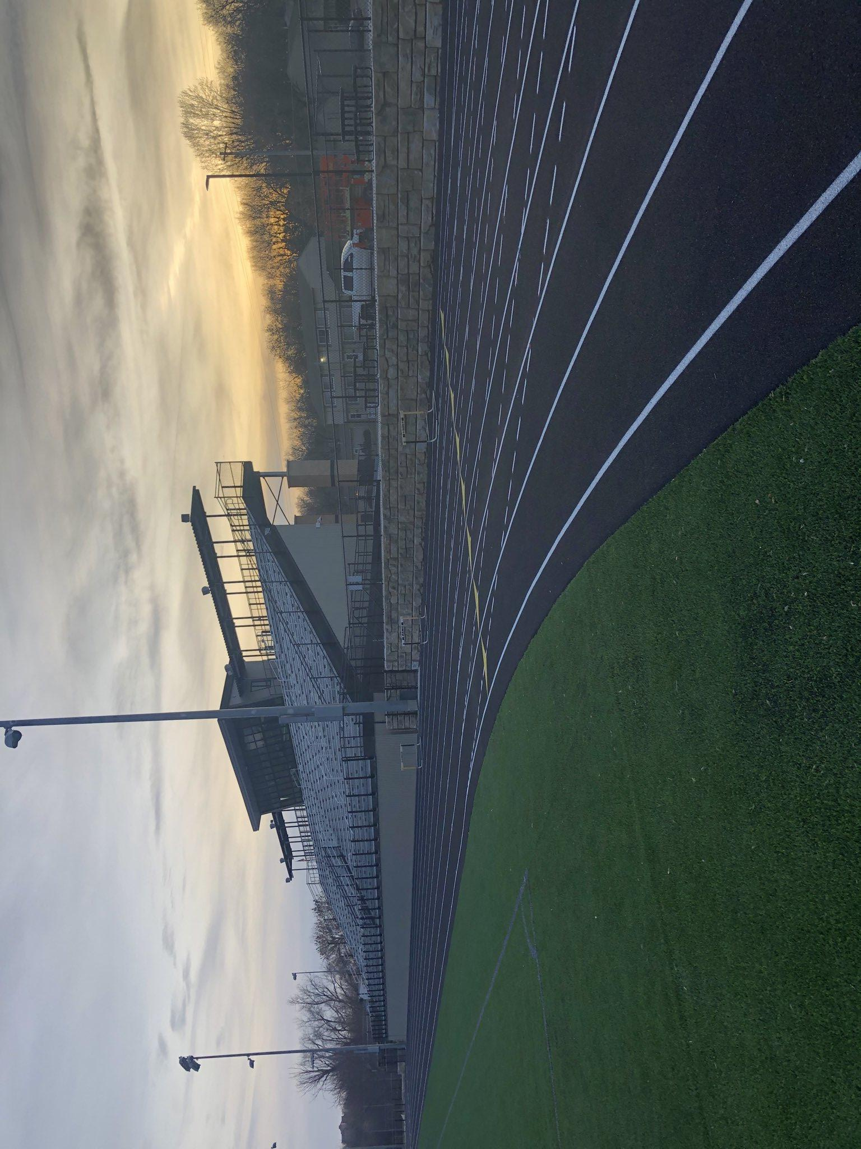
Glenwood Memorial Field Records
Event Record Holder Record School Year
Shot Put Paulette Mitchell 53' 3 ½ Abraham Lincoln 1992
Discus Abby Emisck 154' 8 Lewis Central 2001
Long Jump Darby Thomas 18' 4 Abraham Lincoln 2018
High Jump Ashley Freeman 5' 6 Abraham Lincoln 2001
Tiffanie Synacek 5' 6 Thomas Jefferson 2006
3000 M Run Kelsey Reed 10:44.9 Omaha Burke 1999
4x800 9:54.94 Shenandoah 2001
Shuttle Hurdle Relay 1:05.4 Atlantic 2000
100 M Cheaquetta Bearfield 11.9 Omaha Burke 1997
Distance Medley Relay 4:21.7 Shenandoah 1992
400 M Courtney Jacobs 57.32 Atlantic 2003
4x200 1:46.4 Atlantic 2000
100 M Hurdles Alex Gochenour 14.21 Logan- Magnolia 2011
800 M Missy Buttry 2:18.31 Shenandoah 2001
200 M Merzedes Hart 25.67 Abraham Lincoln 2016
400 M Hurdles Molly Dean 1:03.72 Glenwood 2016
Sprint Medley Relay 1:50.43 Atlantic 2002
1500 M Missy Buttry 4:45.31 Shenandoah 2001
4x100 Relay 50.2 Omaha Burke 1997
4x400 Relay 4:04.95 Harlan 2005

Slide 20
Glenwood Memorial Field Records
Event Record Holder Record School Year
Shot Put Paulette Mitchell 53' 3 ½ Abraham Lincoln 1992
Discus Abby Emisck 154' 8 Lewis Central 2001
Long Jump Darby Thomas 18' 4 Abraham Lincoln 2018
High Jump Ashley Freeman 5' 6 Abraham Lincoln 2001
Tiffanie Synacek 5' 6 Thomas Jefferson 2006
3000 M Run Kelsey Reed 10:44.9 Omaha Burke 1999
4x800 9:54.94 Shenandoah 2001
Shuttle Hurdle Relay 1:05.4 Atlantic 2000
100 M Cheaquetta Bearfield 11.9 Omaha Burke 1997
Distance Medley Relay 4:21.7 Shenandoah 1992
400 M Courtney Jacobs 57.32 Atlantic 2003
4x200 1:46.4 Atlantic 2000
100 M Hurdles Alex Gochenour 14.21 Logan- Magnolia 2011
800 M Missy Buttry 2:18.31 Shenandoah 2001
200 M Merzedes Hart 25.67 Abraham Lincoln 2016
400 M Hurdles Molly Dean 1:03.72 Glenwood 2016
Sprint Medley Relay 1:50.43 Atlantic 2002
1500 M Missy Buttry 4:45.31 Shenandoah 2001
4x100 Relay 50.2 Omaha Burke 1997
4x400 Relay 4:04.95 Harlan 2005

Slide 21
2010-2019 Meet Summaries
Meet | 2010 | 2011 | 2012 | 2013 | 2014 | 2015 | 2016 | 2017 | 2018 | 2019
Clarinda | 3rd | 3rd | 2nd |  | 2nd | 1st | 1st | 1st |  | 1st
Glenwood | 5th | 3rd |  |  | 1st | 1st | 1st | 2nd | 1st | 1st
Shenandoah | 1st | 1st | 2nd
Atlantic | 4th | 3rd | 4th | 2nd | 1st | 3rd | 1st |  |  | 1st(t)
Atlantic JV |  |  |  |  |  |  | 2nd
AL |  |  |  |  |  |  | 1st | 2nd (t) | 2nd | 3rd
Harlan |  |  |  |  |  | 1st
Lewis Central | 3rd |  |  |  |  |  |  |  | 1st | 1st
LC CO-ED | 5th |  | 2nd |  | 2nd | 1st | 1st | 3rd | 1st | 1st
Red Oak | 1st | 1st | 1st | 1st | 1st |  | 1st | 1st | 1st | 1st
FM JV |  |  |  |  |  |  | 4th | 6th |  | 3rd
Glenwood COED | 3rd | 2nd | 1st | 1st | 1st | 1st | 1st | 2nd | 1st | 1st
Glenwood 9-10 |  | 1st | 1st |  | 1st | 1st | 1st | 1st
South Conference | 1st | 1st | 2nd |  | 1st | 1st | 1st | 1st | 1st | 1st
Conference | 7th | 3rd | 3rd
Districts | 5th | 3rd | 4th | 3rd | 2nd | 1st | 2nd | 2nd | 1st | 1st
State | 20th | 32nd |  |  |  |  |  |  |  | 1st

Slide 22
Team Championships
Team Champions Relays Year
Glenwood Atlantic 1984
Glenwood (tied with Missouri Valley) Harlan 1984
Glenwood Woodbine 1986
Glenwood Griswold 1986
Glenwood Red Oak 2001
Glenwood Red Oak 2002
Glenwood Plattsmouth 2002
Glenwood Red Oak 2012
Glenwood Glenwood 9-10 2012
Glenwood Glenwood COED 2012
Glenwood Red Oak 2013
Glenwood Glenwood COED 2013
Glenwood Southern Meet 2014
Glenwood Glenwood 9-10 2014
Glenwood Clarinda 2014
Glenwood Red Oak 2014
Glenwood Ram Relays 2014
Glenwood L.C. COED 2014
Glenwood Ram COED 2014
Glenwood Atlantic COED 2014
Glenwood H-10 Conference 2014
Glenwood Southern Meet 2015
Glenwood Clarinda 2015
Glenwood Harlan 2015
Glenwood Ram Relays 2015
Glenwood L.C. COED 2015
Glenwood Ram COED 2015
Glenwood H-10 Meet 2015
Glenwood District Meet 2015
Glenwood Southern Meet 2016
Glenwood Clarinda 2016
Glenwood Red Oak 2016
Glenwood Ram Relays 2016
Glenwood LC COED 2016
Glenwood Ram COED 2016
Glenwood Atlantic COED 2016
Glenwood AL/TJ 2016
Glenwood H-10 Meet 2016

Slide 23
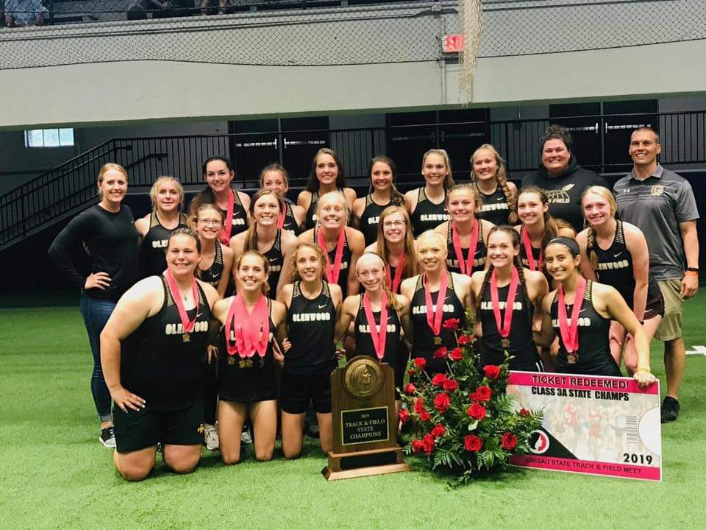

Team Championships
Team Champions Relays Yea
Glenwood Southern Meet 2017
Glenwood Clarinda 2017
Glenwood Red Oak 2017
Glenwood Glenwood 9-10 2017
Glenwood Southern Meet 2018
Glenwood Red Oak 2018
Glenwood LC 2018
Glenwood LC COED 2018
Glenwood Bedford 2018
Glenwood Atlantic COED 2018
Glenwood H-10 Meet 2018
Glenwood Districts 2018
Glenwood Southern Meet 2019
Glenwood Red Oak 2019
Glenwood LC 2019
Glenwood LC COED 2019
Glenwood Clarinda 2019
Glenwood Atlantic COED 2019
Glenwood H-10 Meet 2019
Glenwood Districts 2019
Glenwood State 2019

Slide 24
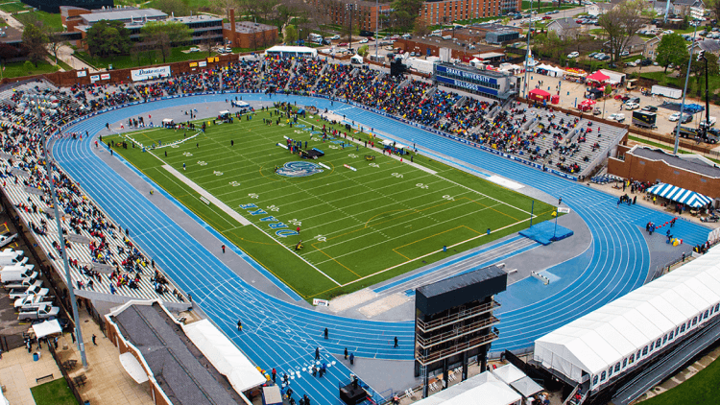
Drake Qualifiers 2018-19
DEVON BOMER 2018 4 X 100 51.88 FAT 47th
JAEDA WILSON
SADEY ALLGOOD
ELLE SCARBOROUGH
AUDREY ARNOLD 2019 4 X 100 51.01 FAT 25th
BAILEY OSTRANDER
JAEDA WILSON
CORYL MATHENY
*SADEY ALLGOOD
*MARISSA AUSDEMORE
*ELLE SCARBOROUGH
*=Ran on a qualifying team
AUDREY ARNOLD 2019 4 X 200 1:48.18 FAT 22nd
BAILEY OSTRANDER
JAEDA WILSON
CORYL MATHENY
*SADEY ALLGOOD
CORYL MATHENY 2019 SPRINT MEDLEY 1:55.86 FAT 22nd
BAILEY OSTRANDER
JAEDA WILSON
ABBY HUGHES
*SADEY ALLGOOD
*JANETTE SCHRAFT
AUDREY ARNOLD 2019 SHUTTLE HURDLE RELAY DQ (1:07.51)
MARISSA AUSDEMORE
SAMI PARR
ELLE SCARBOROUGH
CORYL MATHENY 2019 HIGH JUMP 5’2” 10th
ELLE SCARBOROUGH 2019 100 HURDLES 16.02 FAT 24th
SYDNEY BIERMANN 2019 SHOT PUT 37-02 11th
ELLE SCARBOROUGH 2019 DISCUS 109-07 23rd
JANETTE SCHRAFT 2019 3000 10:09.49 4th
JANETTE SCHRAFT 2019 1500 4:48.63 FAT 7th
JANETTE SCHRAFT 2019 800 2:11.55 FAT 5th
*22nd time all time in Iowa History
JANETTE SCHRAFT 2019 400 HURDLES 63.21 FAT 1st

Slide 25

Hawkeye 10 Conference Meet Results
2010-2019
2010 Harlan 163 Atlantic 97 Creston 64 Denison/Sch. 61 Lewis Central 50 Clarinda 47 Glenwood 39 Shenandoah 28 Red Oak 28 Kuemper 12 | 2011 Harlan 178 Atlantic 110 Glenwood 99 Denison/Sch. 48 Creston 47 Lewis Central 42 Clarinda 37 Shenandoah 14 Red Oak 7 Kuemper 7 | 2012 Harlan 149 Creston 120 Glenwood 100 Atlantic 71 Deison/Sch. 61 Shenandoah 38 Kuemper 25 Clarinda 16 Lewis Central 7.5 Red Oak 1.5 | 2013 Harlan 175 Glenwood 138 Creston 78 Shenandoah 49 Denison/Sch. 42 Clarinda 34 Kuemper 30 Atlantic 21 Lewis Central 13 Red Oak 9 | 2014 Glenwood 147.5 Harlan 116 Creston 85 Shenandoah 74 Denison/Sch. 66 Clarinda 60 Kuemper 49 Lewis Central 46.5 Saint Albert 36 Atlantic 30.5 Red Oak 29.5
2015 Glenwood 147.5 Harlan 114 Creston 108 Shenandoah 90.5 Lewis Central 61.5 Dension/Sch. 57 Clarinda 53 Atlantic 41.5 Kuemper 32 Red Oak 25 Saint Albert 11 | 2016 Glenwood 146 Creston 133 Denison/Sch. 126 Atlantic 72 Harlan 71 Shenandoah 56 Lewis Central 55 Clarinda 31.5 St. Albert 19 Red Oak 19 Kuemper 12 | 2017 Denison/Sch. 147 Lewis Central 106 Harlan 102 Creston 97 Glenwood 89 Shenandoah 67 Atlantic 38.5 Red Oak 35 Clarinda 24.5 St. Albert 18 Kuemper 16 | 2018 Glenwood 161 Denison 123 Creston 79 Lewis Central 75 Atlantic 72 Shenandoah 65 Harlan 45 Red Oak 38 Kuemper 37 St. Albert 32.5 Clarinda 12 | 2019 Glenwood 193 Atlantic 115 Harlan 97 Creston 88 Denison/Sch. 73 Lewis Central 58.5 Shenandoah 35 Clarinda 22.5 Kuemper 21 St. Albert 19 Red Oak 18

Slide 26
Hawkeye 10 Conference Champions
2010-2019
Conference Champions Year Event Time/ Distance
Abby Brown, Devin Jackson 2010 Shuttle Hurdle 1:09.0
Kassie Finn, Mercedes Liparoto
Cassie Kruse 2011 Discus 104’7
Cassie Kruse 2012 Shot Put 39’2 ¼
Kecia Caudill 2012 100 M Dash 12.58
Reiny Ostrander, Kecia Caudill 2012 4x100 51.75
Sarah Salerno, Chelsea Webster
Jacy Embray 2013 Shot Put 37’ 1 ½
Kecia Caudill 2013 100 M Dash 12.64
Molly Dean 2013 400 M Hurdles 1:08.13
Reiny Ostrander, Kecia Caudill 2013 4x100 51.75
Rebecca Fornoff, Courtney Magnussen
Jacy Embray 2014 Shot Put 38’7
Miranda Ruth 2014 100 M Hurdles 16.66
Miranda Ruth, Ashley Konfrst 2014 Shuttle Hurdle 1:09.96
McKenzie Becker, Olivia Scarborough
Jacy Embray 2015 Shot Put 43’4 ½
Jacy Embray 2015 Discus 124’9
Olivia Scarborough, Ashley Konfrst 2015 Shuttle Hurdle 1:09.08
McKenzie Becker, Miranda Ruth
Miranda Ruth 2015 100 Hurdles 16.47

Slide 27
Hawkeye 10 Conference Champions
Conference Champions Year Event Time/ Distance
Kaycee Clark 2016 100 M Dash 13.16
Kaycee Clark 2016 200 M Dash 27.23
Molly Dean 2016 400 M Dash 59.11
Molly Dean 2016 100 M Hurdles 15.83
Molly Dean 2016 400 M Hurdles 1:04.80
Linnaea Konfrst 2016 Discus 128’0
Linnaea Konfrst 2016 Shot Put 40’10
Emma Hughes 2018 1500 5:02.51
Bailey Ostrander, Devon Bomer 2018 4x100 51.82
Jaeda Wilson, Elle Scarborough
Abi Schultz, Devon Bomer 2018 4x200 1:49.48
Elle Scarborough, Bailey Ostrander
Bailey Ostrander, Devon Bomer 2018 Sprint Medley 1:54.73
Sadey Allgood, Elle Scarborough
Coryl Matheny 2019 High Jump 5’02
Jaeda Wilson 2019 100 13.06 FAT
Jaeda Wilson 2019 400 1:00.30 FAT
Audrey Arnold 2019 100 Hurdles 16.21 FAT
Janette Schraft 2019 800 2:22.38 FAT
Janette Schraft 2019 400 Hurdles 1:07.97 FAT
Janette Schraft 2019 1500 4:54.98 FAT
Audrey Arnold, Bailey Ostrander 2019 4x100 51.44 FAT
Marissa Ausdemore, Lauren Roenfeldt
Jaeda Wilson, Abby Hughes 2019 4x400 4:07.87 FAT
Abi Schultz, Coryl Matheny

Slide 28
Hawkeye 10 Conference Records
Event Name Time Year
Shot Put Brenda Konfrst 45' 1 1986
Discus Brenda Konfrst 142' 10 1986
Long Jump Linda Rowe 16' 11 ½ 1970
High Jump Claire Bristow 5' 5 2006
100 Meters Laurie Maiers 12.3 1975
200 Meters Pat Hidgson 26.2 1974
400 Meters Janette Shraft 57.64 2019
800 Meters Janette Shraft 2:11.31 2019
1500 Meters Janette Shraft 4:41.29 2019
3000 Meters Janette Shraft 10:09.25 2019
100 Hurdles Molly Dean 15.18 2016
400 Hurdles Janette Shraft 1:02.97 2019
4x100 Relay C. Webster, K. Caudill 49.29 2013
S. Salerno, C. Magnussen
4x200 Relay S. Allgood, K. Caudill 1:45.48 2019
J. Wilson, C. Mathney
4x400 Relay J. Wilson, A. Hughes 4:02.59 2019
A. Schultz, C. Matheny
4x800 Relay M. Rohrberg, S. Richter 9:52.7 1977
M. Crouch, M. Rohrberg
Sprint Medley S. Allgood, B. Ostrander 1:49.63 2019
Relay J. Wilson, J. Shraft
Distance Medly C. Pazerka, J. Mingo 4:11.7 1974
Relay T. McGinnis, P. Hodgson
Shuttle Hurdle A. Arnold, M. Ausdemore 1:05.27 2019
Relay S. Parr, E. Scarborough

Slide 29
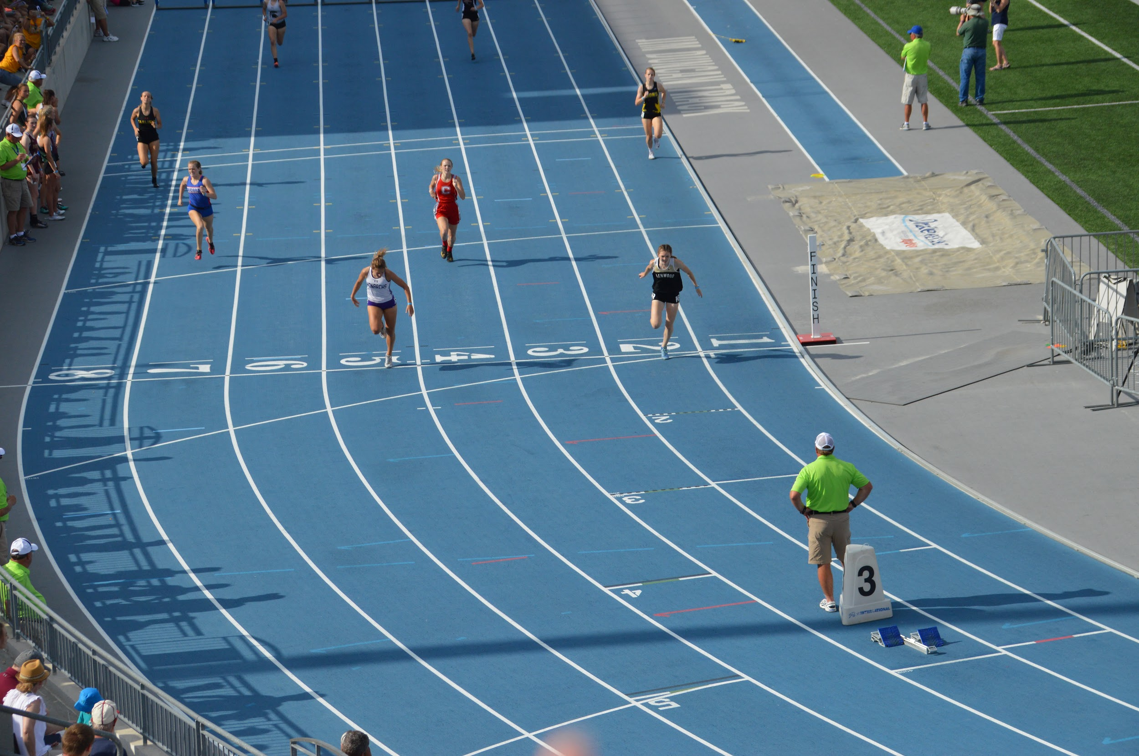
State Meet Qualifiers 2017
Danielle Hardcastle 2017 4x800 10:06.37 15th
Kate Kaufman
Arianna Springer
Jillian Finnegan
Jaeda Wilson 2017 4x200 1:49.50 12th
Devon Bomer
Bailey Ostrander
Sadey Allgood
Jaeda Wilson 2017 4x400 4:18.31 22nd Danielle Hardcastle
Sadey Allgood
Devon Bomer
Sydney Biermann 2017 Shot Put 33’ 8.5” 23rd
Katelyn Wilwerding 2017 400 Hurdles 1:12.60 24th

Slide 30
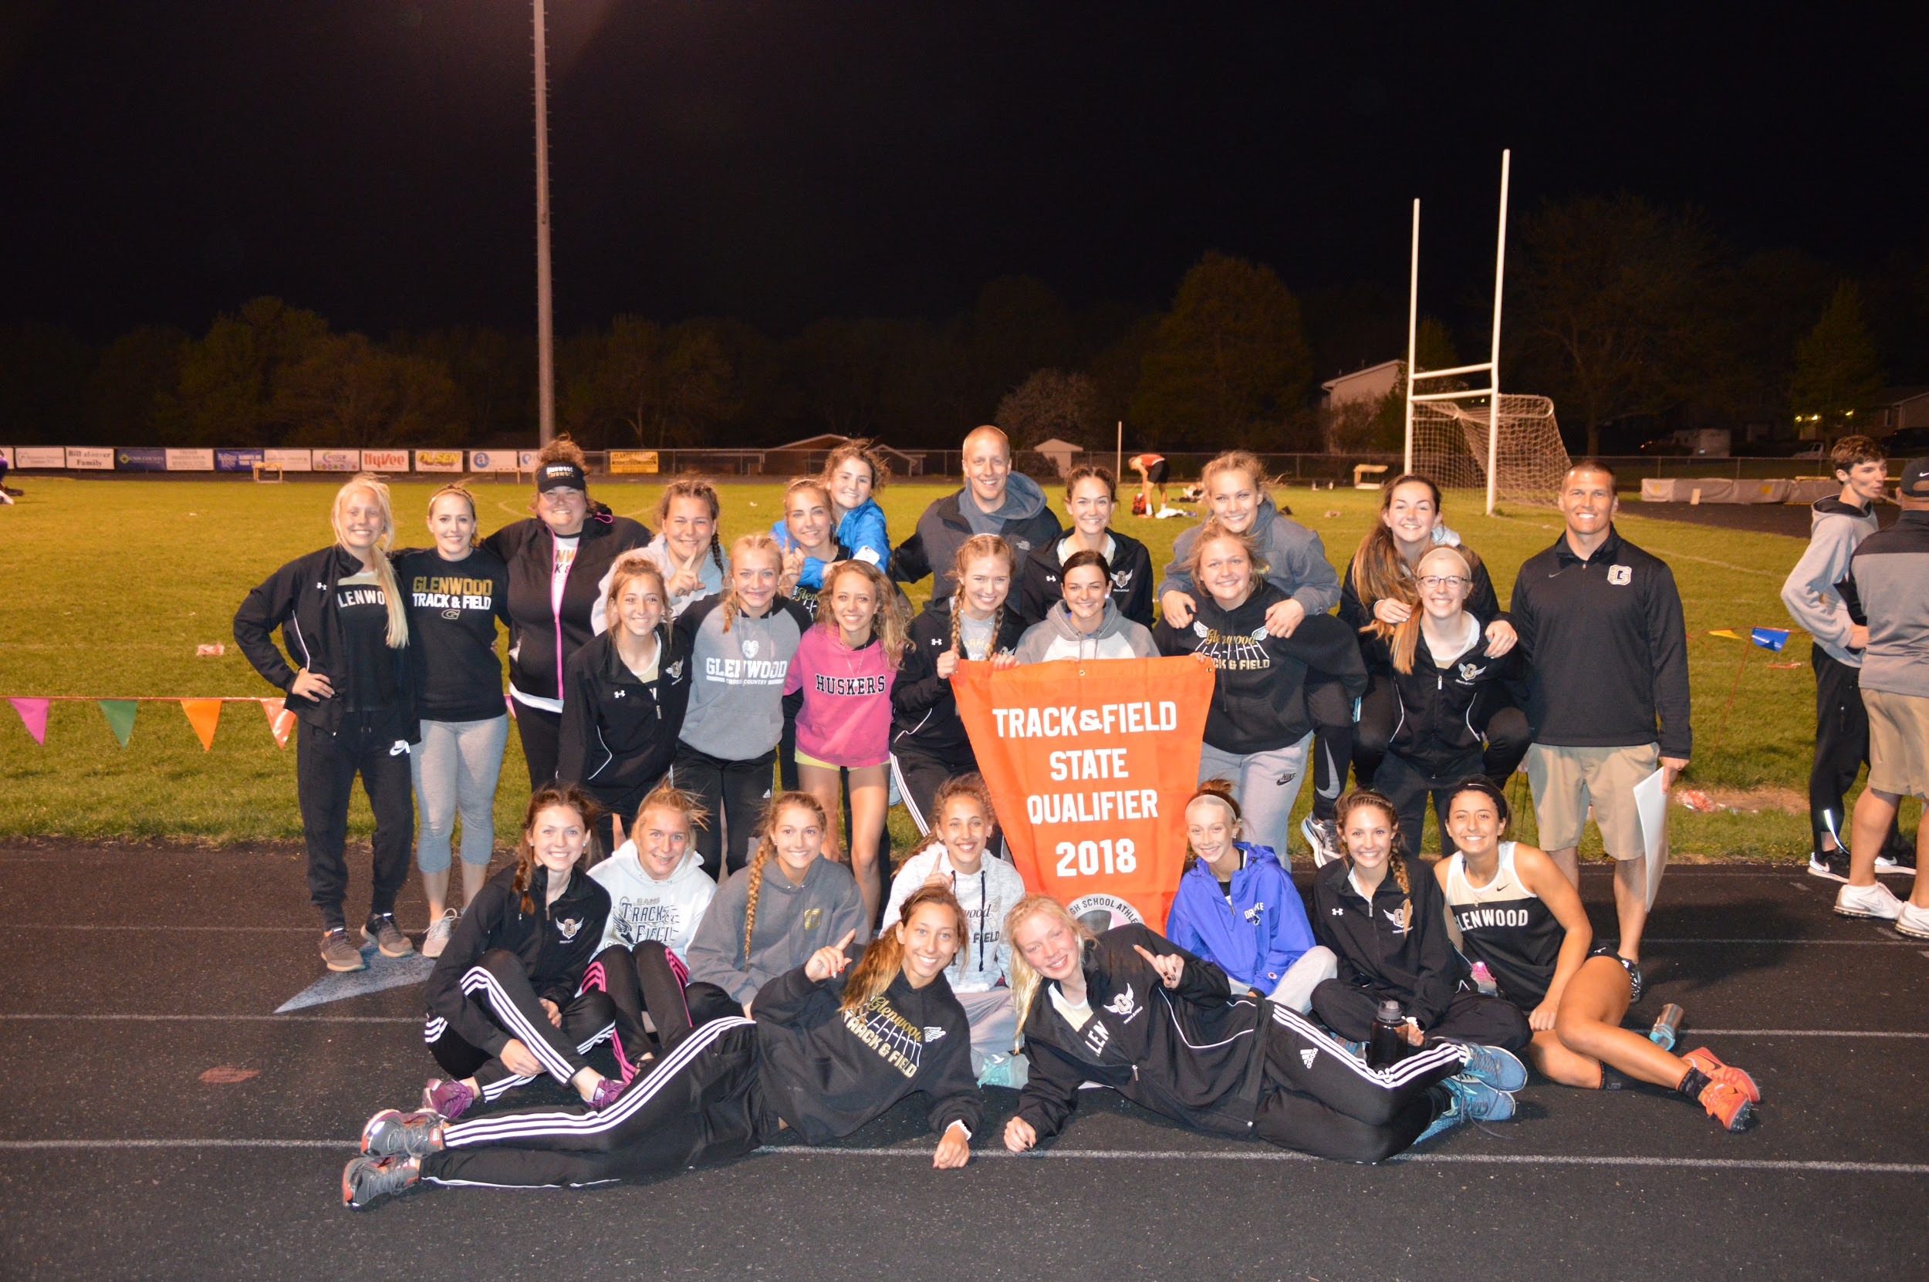
State Meet Qualifiers 2018
Lauren Becker 2018 400 Hurdles 1:06.96 10th
Emma Hughes 2018 1500 5:00.35 14th
Abi Schultz 2018 Sprint Medley 1:55.45 18th
Jaeda Wilson
Devon Bomer
Elle Scarborough
Audrey Arnold 2018 100 Hurdles 16.18 20th
Sadey Allgood 2018 200 Dash 26.47 16th
Devon Bomer 2018 4 x 100 51.60 20th
Jaeda Wilson
Bailey Ostrander
Elle Scarborough
Sadey Allgood 2018 4 x 200 1:48.59 13th
Elle Scarborough
Jaeda Wilson
Bailey Ostrander
Danielle Hardcastle 2018 4 X 800 9:53.70 9th
Lauren Becker
Kate Kaufman
Abby McIntyre
Lauren Becker 2018 High Jump 5’1” 13th
Danielle Hardcastle 2018 High Jump 4’11” 14th
Sami Parr 2018 Shuttle Hurdle 1:09.07 13th
Taryn Bertini
Audrey Arnold
Marissa Ausdemore
Elle Scarborough 2018 Discus 98’3” 23rd
Emma Hughes 2018 3000 11:00.93 11th
Sydney Biermann 2018 Shot Put 35-00 18th

Slide 31

State Meet Qualifiers 2019
State Champions
Sydney Biermann 2019 Shot Put 37-03.75 6th
Sydney Biermann 2019 Discus 112-10 12th
Coryl Matheny 2019 High Jump 5-02 T-7th
Jaeda Wilson 2019 400 60.73 FAT 7th
Bailey Ostrander 2019 100 13.42 FAT 19th
Janette Schraft 2019 400 Hurdles 63.5 FAT 1st
Janette Schraft 2019 800 2:12.28 FAT 1st
Janette Schraft 2019 1500 4:41.53 FAT 1st
Janette Schraft 2019 3000 10:35.49 FAT 1st
Sadey Allgood 2019 4 X 200 1:45.72 FAT 4th
Bailey Ostrander
Marissa Ausdemore
Jaeda Wilson
Coryl Matheny
Sadey Allgood 2019 4 X 100 51.21 FAT 9th
Bailey Ostrander
Marissa Ausdemore
Jaeda Wilson
Elle Scarborough
Jaeda Wilson 2019 4 X 400 4:03.60 FAT Final 6th
Abby Hughes 4:02.83 FAT Prelims
Abi Schultz
Coryl Matheny
Elle Scarborough 2019 100 Hurdles 15.85 FAT 8th
Audrey Arnold 2019 100 Hurdles 16.34 FAT 17th
Audrey Arnold 2019 Shuttle Hurdle Relay 65.51 FAT 1st
Sami Parr
Marissa Ausdemore
Elle Scarborough
Audrey Arnold 2019 Sprint Medley 1:53.21 FAT 9th
Marissa Ausdemore
Bailey Ostrander
Jaeda Wilson
Coryl Matheny
Abby McIntyre 2019 4 X 800 10:02.48 11th
Lauren Becker
Erin Schultz
Emma Hughes

Slide 32


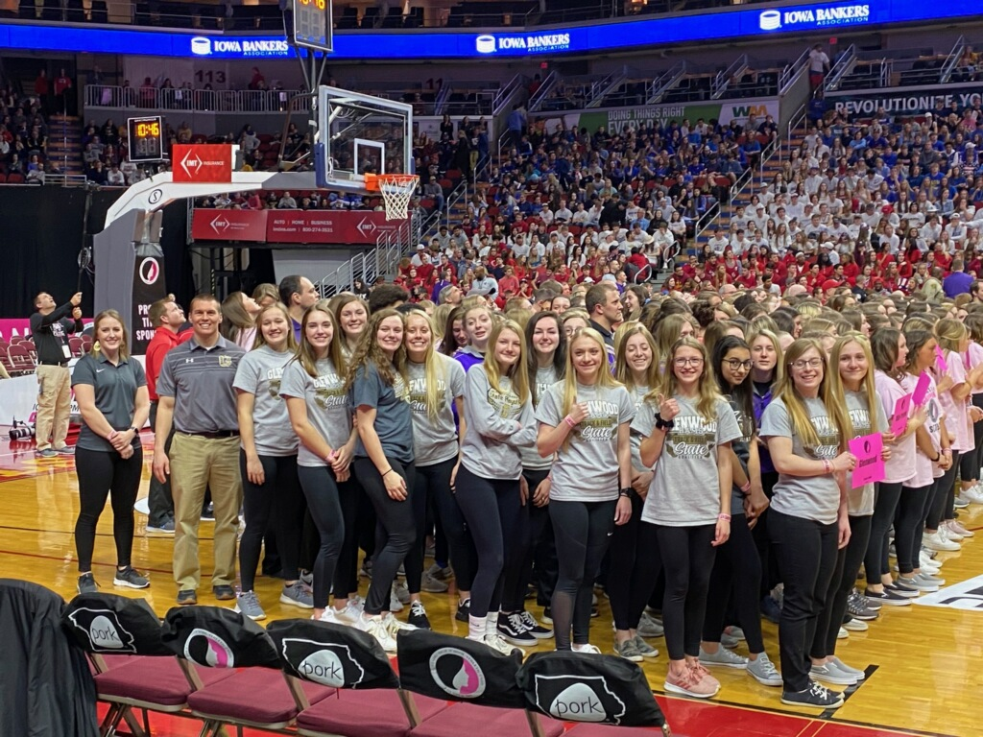
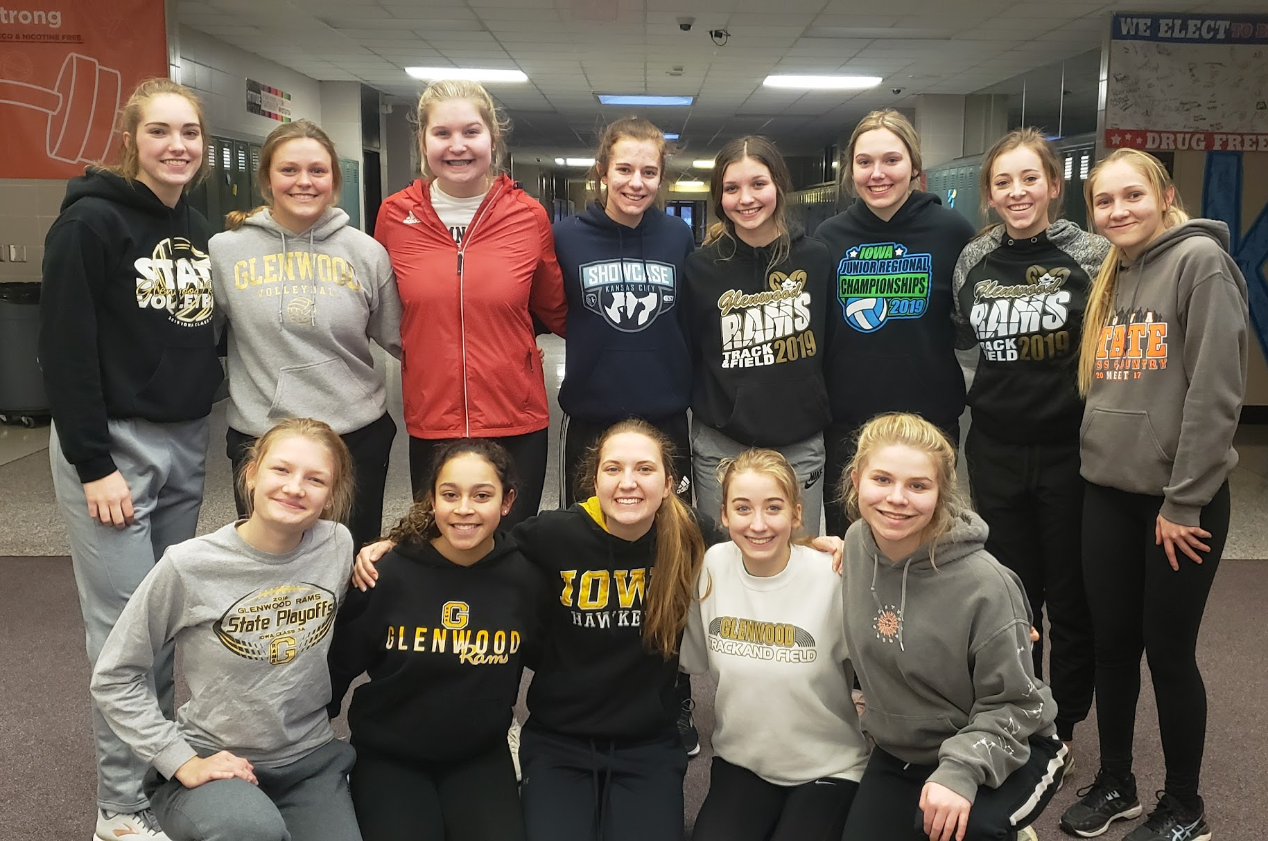

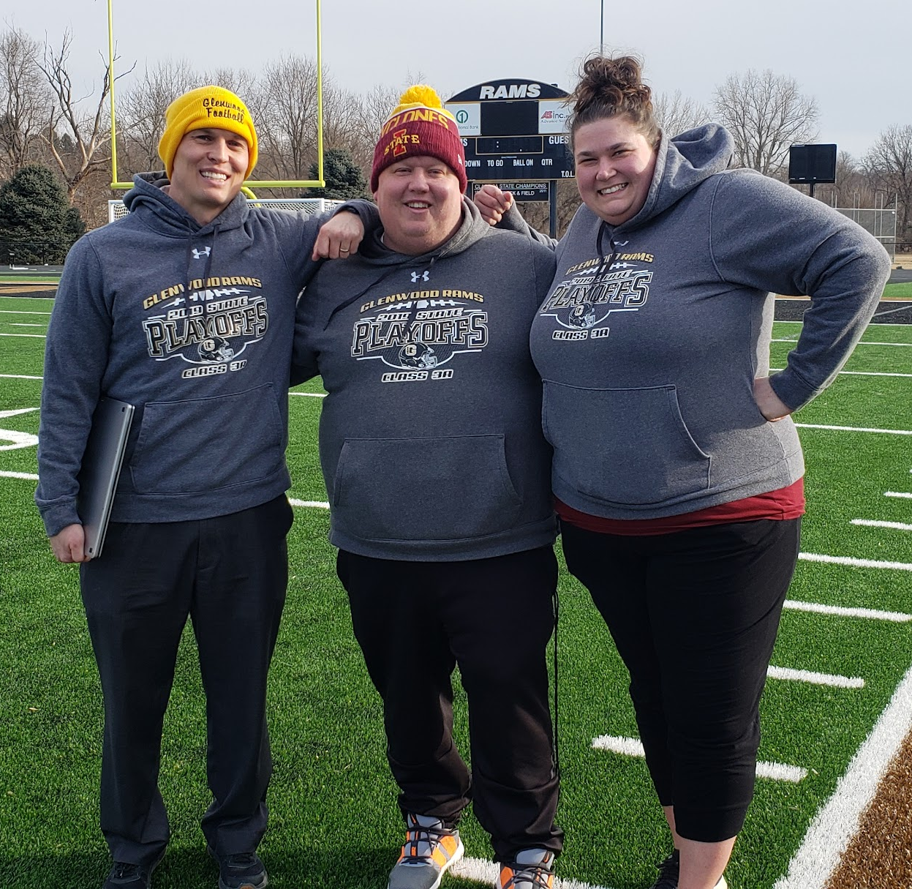
Our Track Family

Slide 33
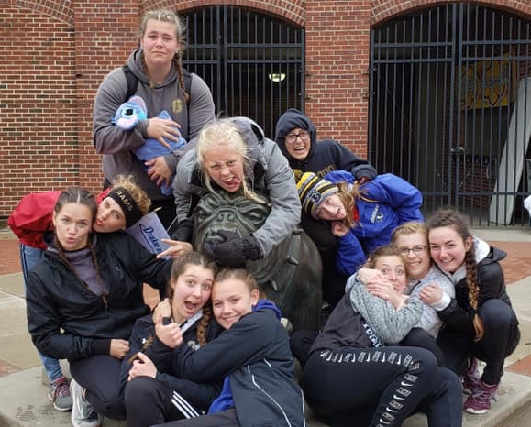
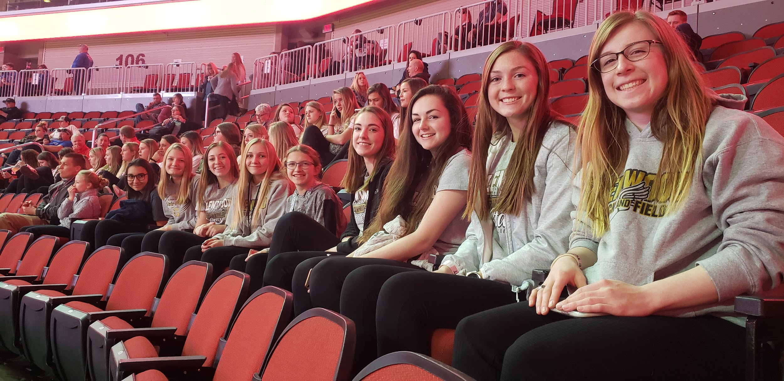
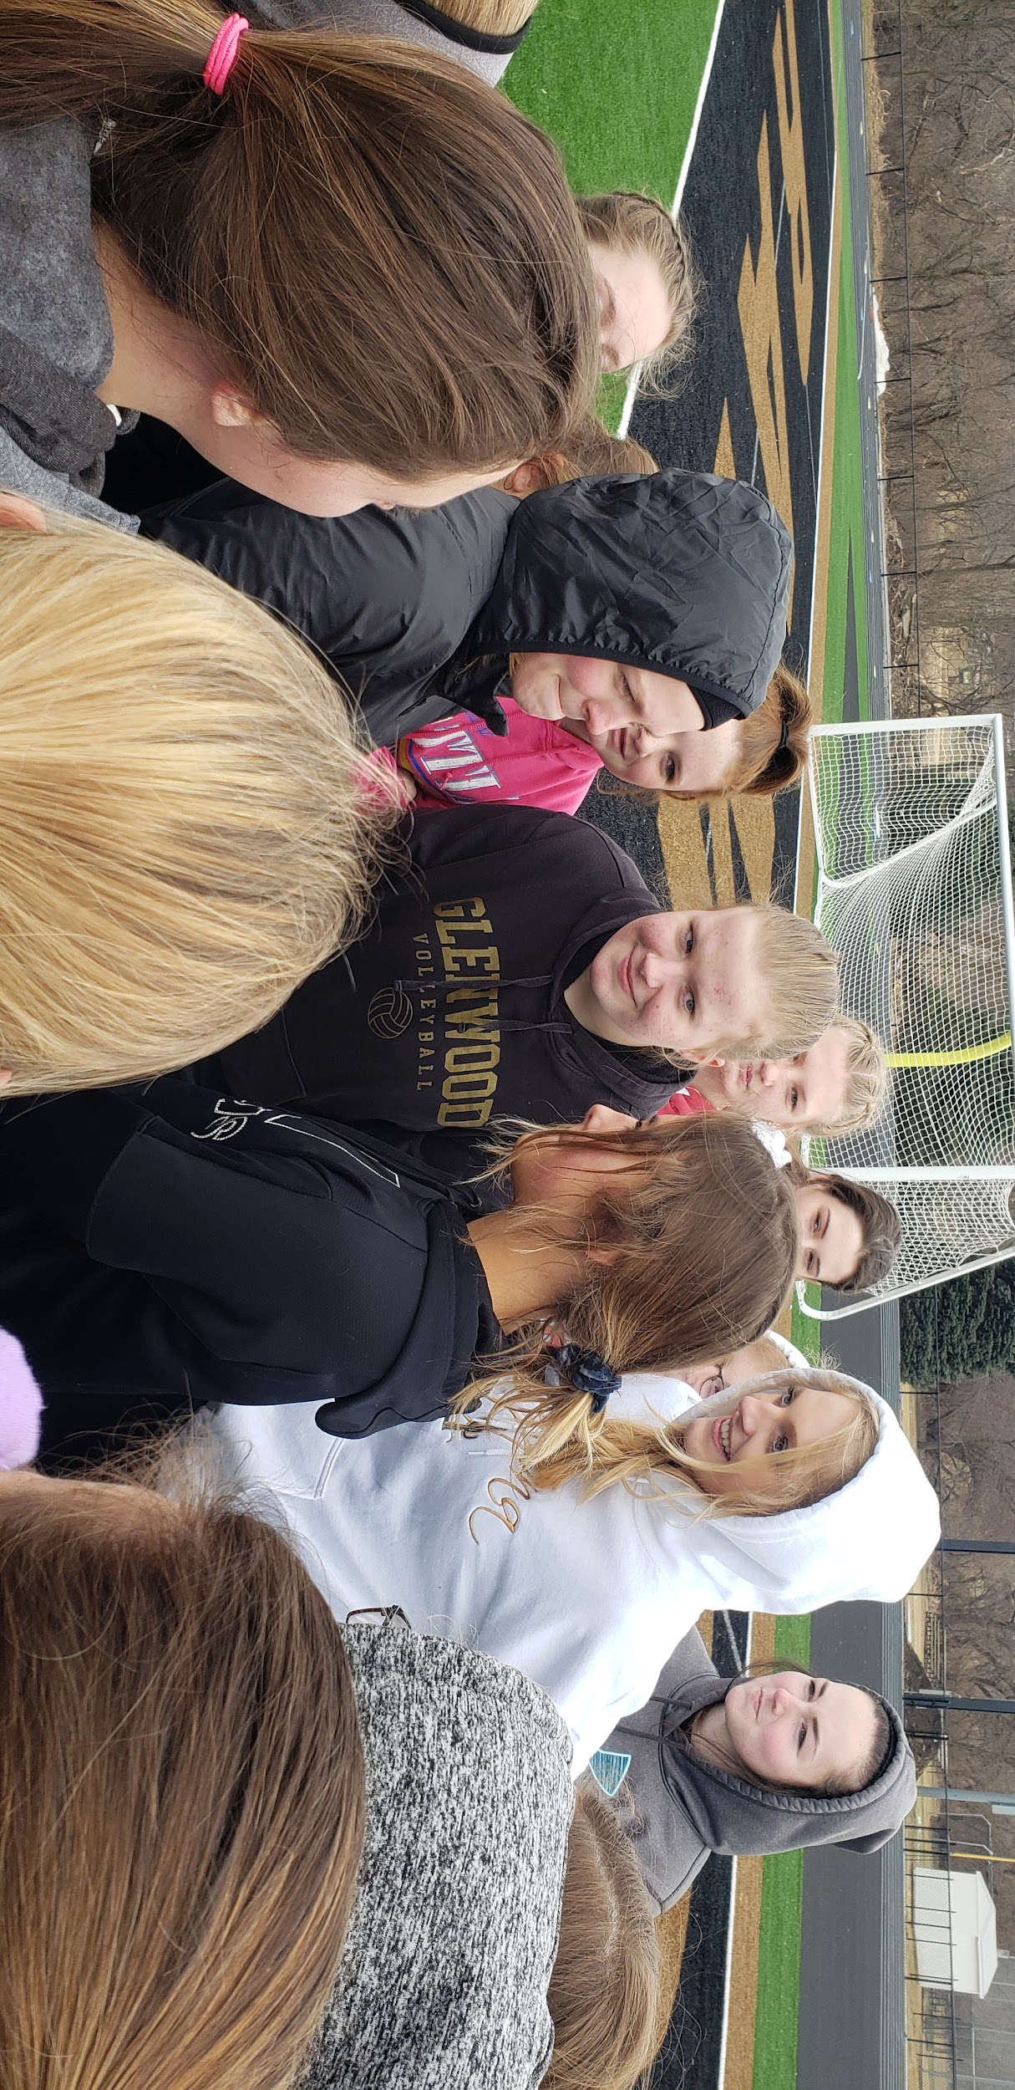
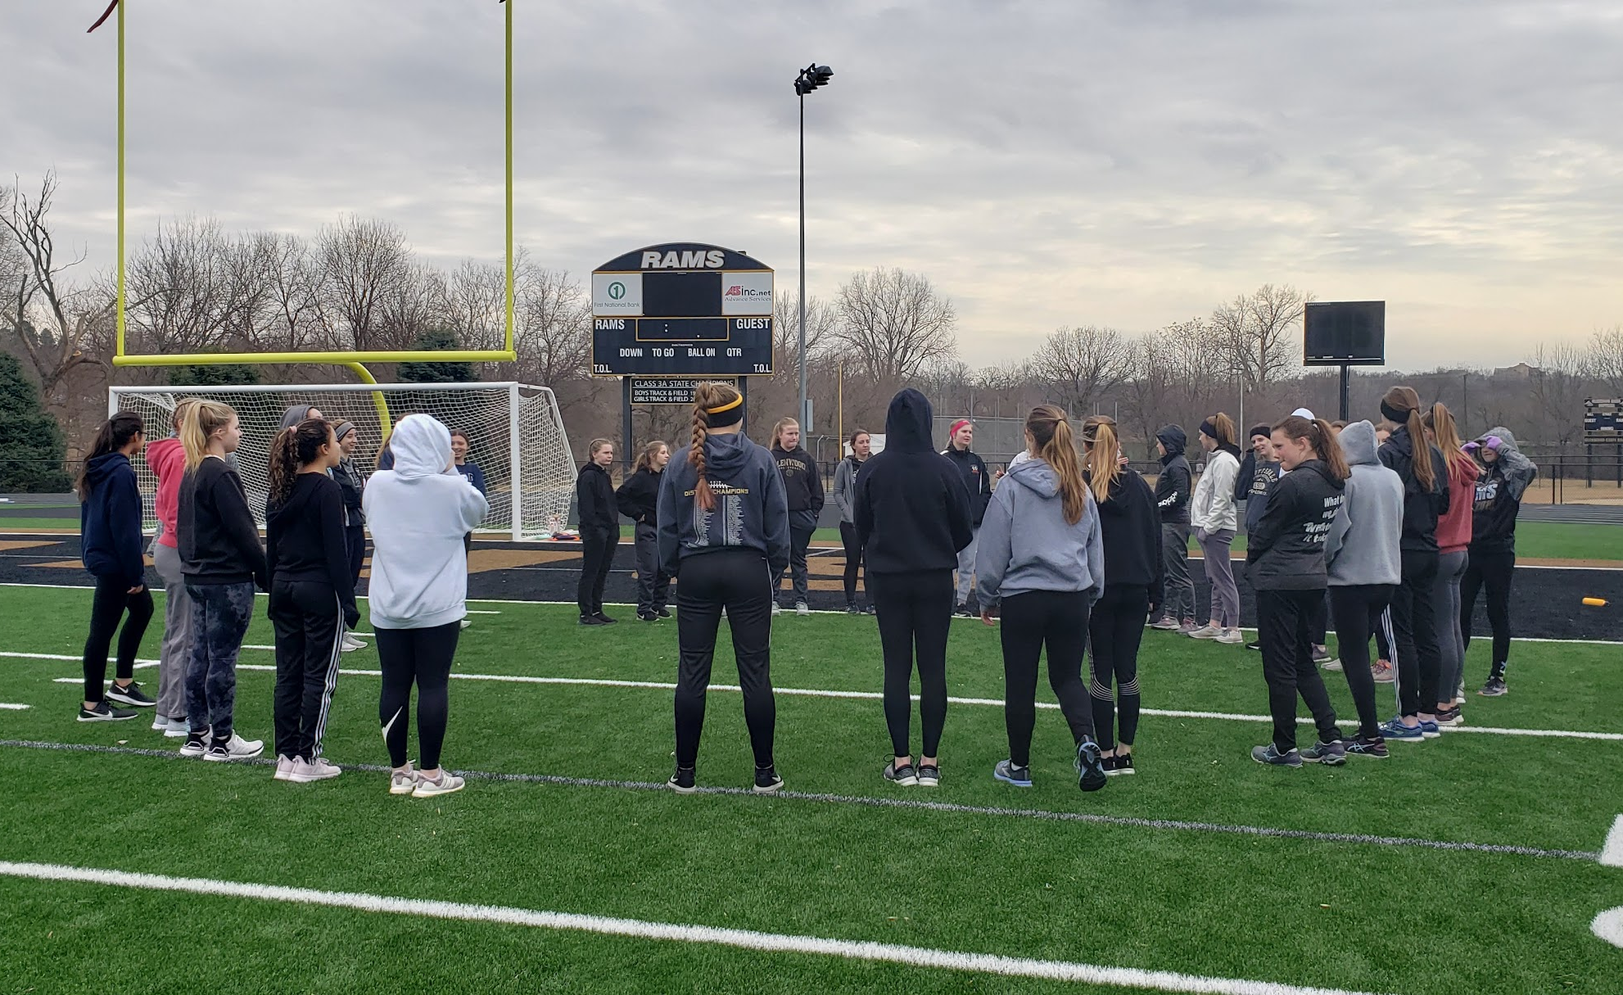

Slide 34

